Slide 2
What is ISMP?
The International Symposium on Mathematical Programming (ISMP) is a triennial conference on mathematical optimization, gathering scientists from around the world to present and share their most recent advances and development in the field.
It has more than 2000 participants with more than 1500 presentations.

Slide 3
History of ISMP
 | Location | Year |  | Location | Year
1st ISMP | Washington DC, USA | 1951 | 2nd ISMP | Washington DC, USA | 1955
3rd ISMP | Santa Monica, USA | 1959 | 4th ISMP | Chicago, USA | 1962
5th ISMP | London, UK | 1964 | 6th ISMP | Princeton, USA | 1967
7th ISMP | The Hague, The Netherlands | 1970 | 8th ISMP | Stanford, USA | 1973
9th ISMP | Budapest, Hungary | 1976 | 10th ISMP | Montreal, Canada | 1979
11th ISMP | Bonn, Germany | 1982 | 12th ISMP | Boston, USA | 1985
13th ISMP | Tokyo, Japan | 1988 | 14th ISMP | Amsterdam, The Netherlands | 1991
15th ISMP | Ann Arbor, USA | 1994 | 16th ISMP | Lausanne, Switzerland | 1997
17th ISMP | Atlanta, USA | 2000 | 18th ISMP | Copenhagen, Denmark | 2003
19th ISMP | Rio de Janeiro, Brazil | 2006 | 20th ISMP | Chicago, USA | 2009
21st ISMP | Berlin, Germany | 2012 | 22nd ISMP | Pittsburgh, PA, USA | 2015
23rd ISMP | Bordeaux, France | 2018 | 24th ISMP | Online | 2022
25th ISMP | Montréal, Canada | 2024 | 26th ISMP | Amsterdam, The Netherlands | 2027

Slide 4
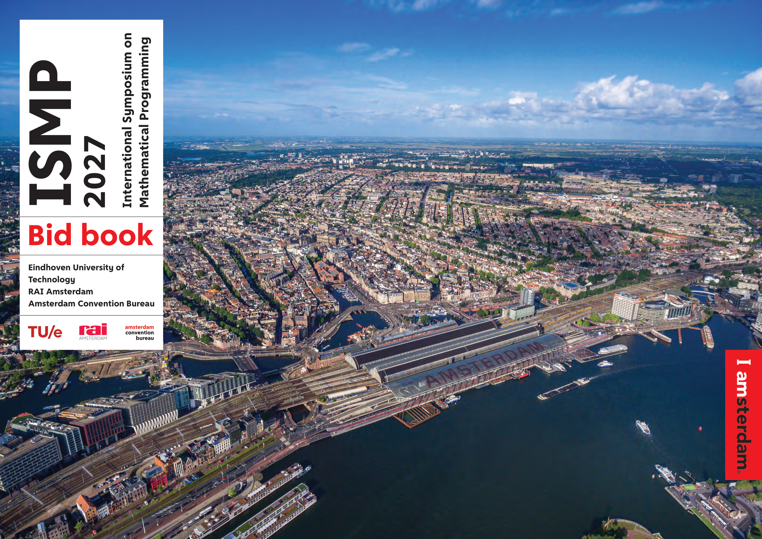
How did we bring ISMP 2027 to NL?
Fall 2023: Ahmadreza Marandi asks for bids from venues in NL.
February 2024: preliminary bid sent
May 2024: full bid sent to MOS
Includes support letters from: - LNMB, VVSOR, BETA, PWN, KNAW
- TU/e, Twente, UvA, VU & CWI.
- Mayor of Amsterdam
- Amsterdam Convention Bureau
July 2024: ISMP 2027 is officially announced at business meeting of ISMP 2024 in Montreal.

Slide 5
Local Organization
Conference Co-Chairs
Karen Aardal TU Delft
Daniel Dadush CWI & Utrecht University
Monique Laurent CWI & Tilburg University
Ahmadreza Marandi TU Eindhoven
Subcommittee Chairs
Budget: Monique Laurent, Ahmadreza Marandi, Maria Vlasiou
Diversity: Karen Aardal, Sophie Huiberts, Daniel Dadush
Fundraising: Marjan van den Akker, Daniel Dadush, Jan Karel Lenstra, Ahmadreza Marandi, Albert Schrotenboer, Marc Uetz
Website & Program: Christopher Hojny, Matthias Walter
Satellite & Outreach: Karen Aardal, Ilker Birbil
Social Program: Tim Oosterwijk, Guido Schäfer, Leen Stougie, Tjark Vredeveld

Slide 6
Local Organizers
Albert Schrotenboer, TU Eindhoven
Renata Sotirov, Tilburg University
Frits Spieksma, TU Eindhoven
Leen Stougie, CWI and VU Amsterdam
Marc Uetz, University of Twente
Juan Vera Lizcano, Tilburg University
Maria Vlasiou, University of Twente
Tjark Vredeveld, University of Maastricht
Matthias Walter, University of Twente
Bert Zwart, CWI and TU Eindhoven
Ivo Adan, TU Eindhoven
Marjan van den Akker, Utrecht University
Ilker Birbil, University of Amsterdam
Richard Boucherie, University of Twente
Christopher Hojny, TU Eindhoven
Sophie Huiberts, CNRS, Clermont Auvergne University
Jan Karel Lenstra, CWI
Tim Oosterwijk, VU Amsterdam
Juan Peypouquet, University of Groningen
Guido Schäfer, CWI and University of Amsterdam

Slide 7
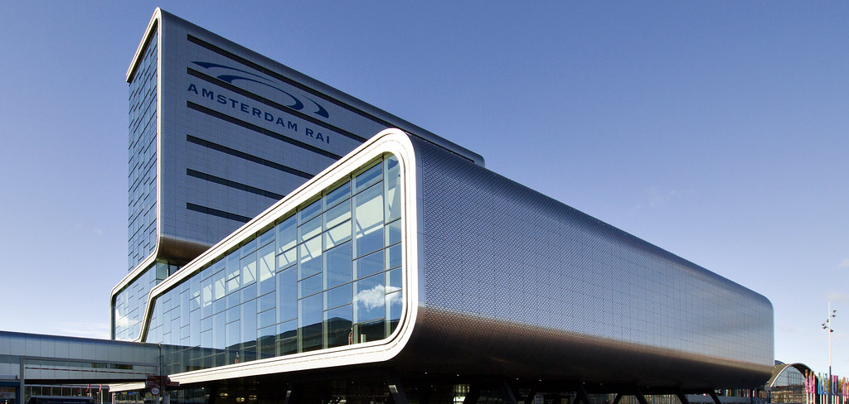
Location

Slide 8
Location
RAI to/from | Time (minutes)
Amsterdam Central Station | 8 (metro) 20 (cycling) 60 (walking)
Amsterdam Zuid Station | 6 (metro) 4 (cycling) 21 (walking)
Amsterdam Amstel Station | 15 (metro) 10 (cycling) 30 (walking)
Train Station
Metro Station

Slide 9
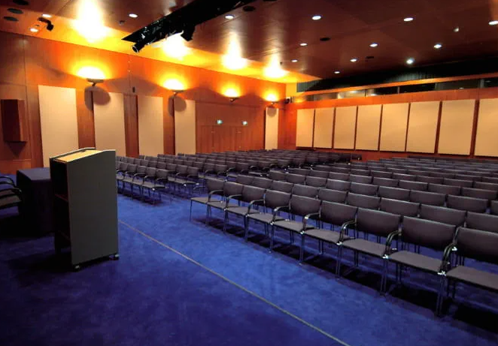
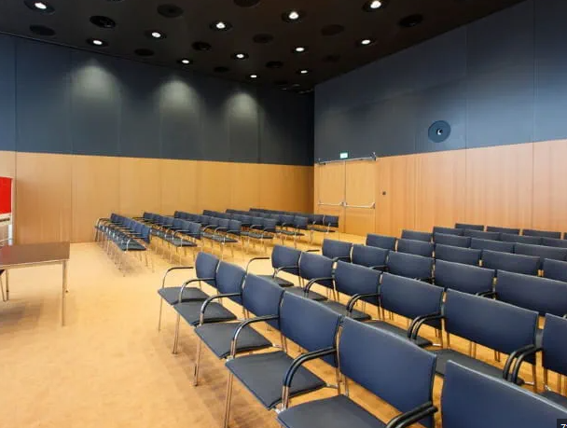
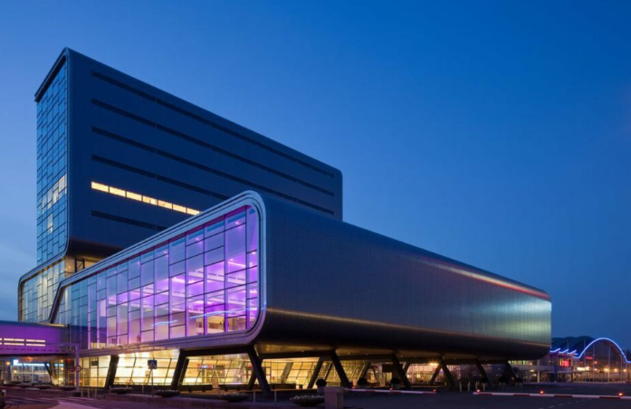
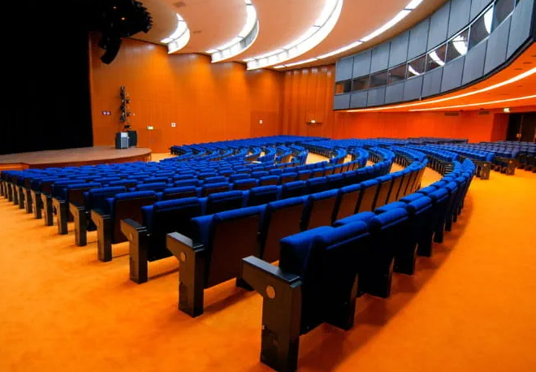
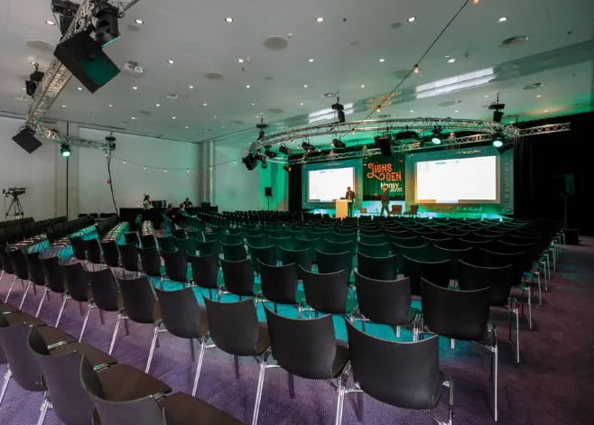
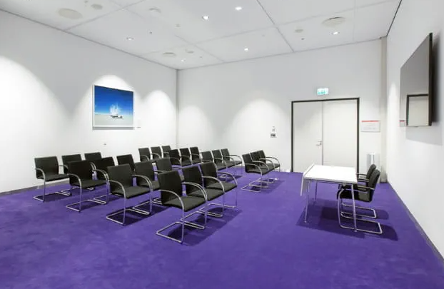
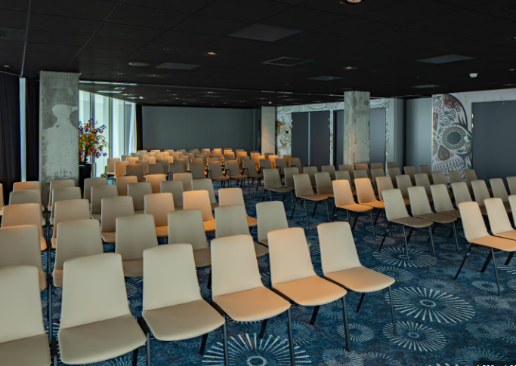
RAI Facilities
Capacity (seats) | Number of rooms
$$[700,1700]$$ | 4
$$[95,300]$$ | 16
$$[70,90]$$ | 7
$$[28,50]$$ | 17

Slide 10
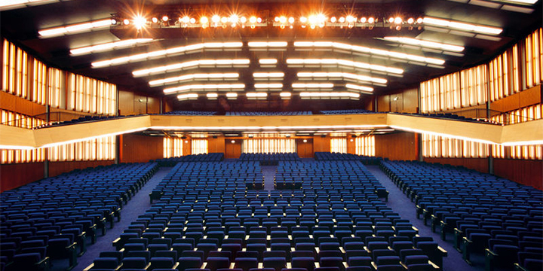
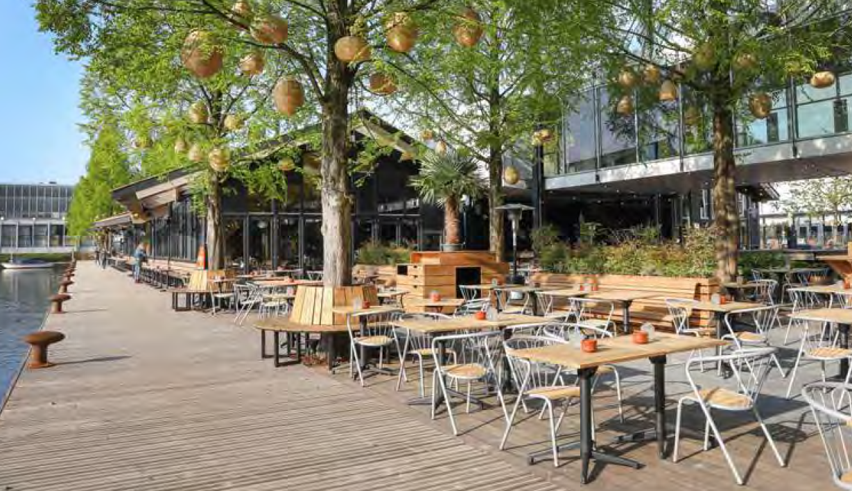
Social Program
Welcome Reception & Opening Ceremony at Auditorium RAI
Farewell Reception at Strand Zuid
(tentative)

Slide 11
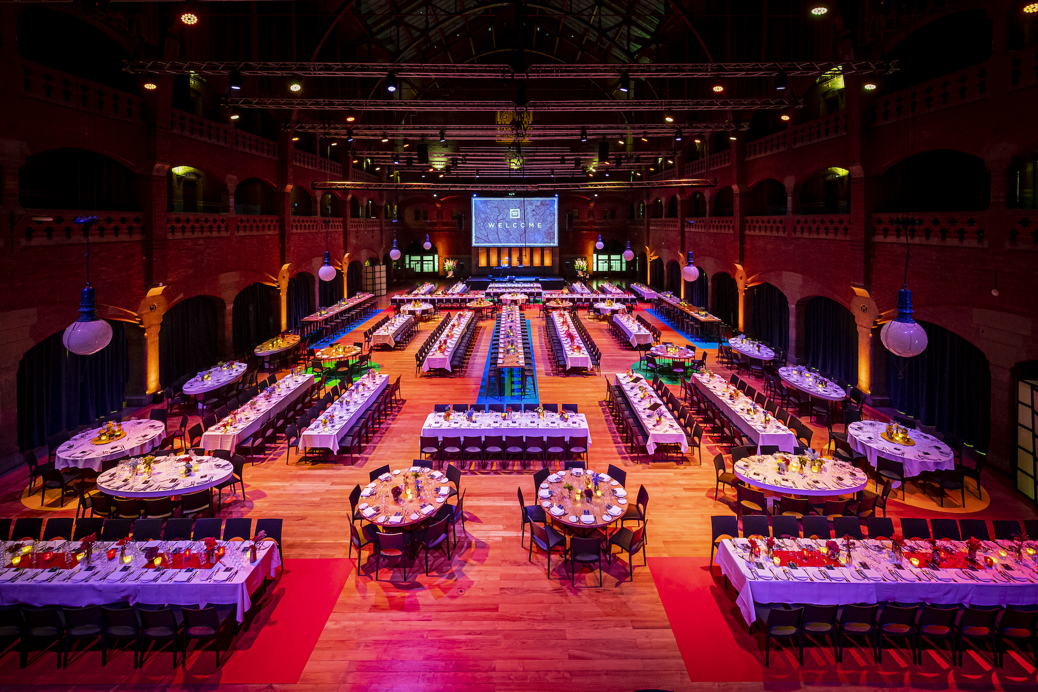
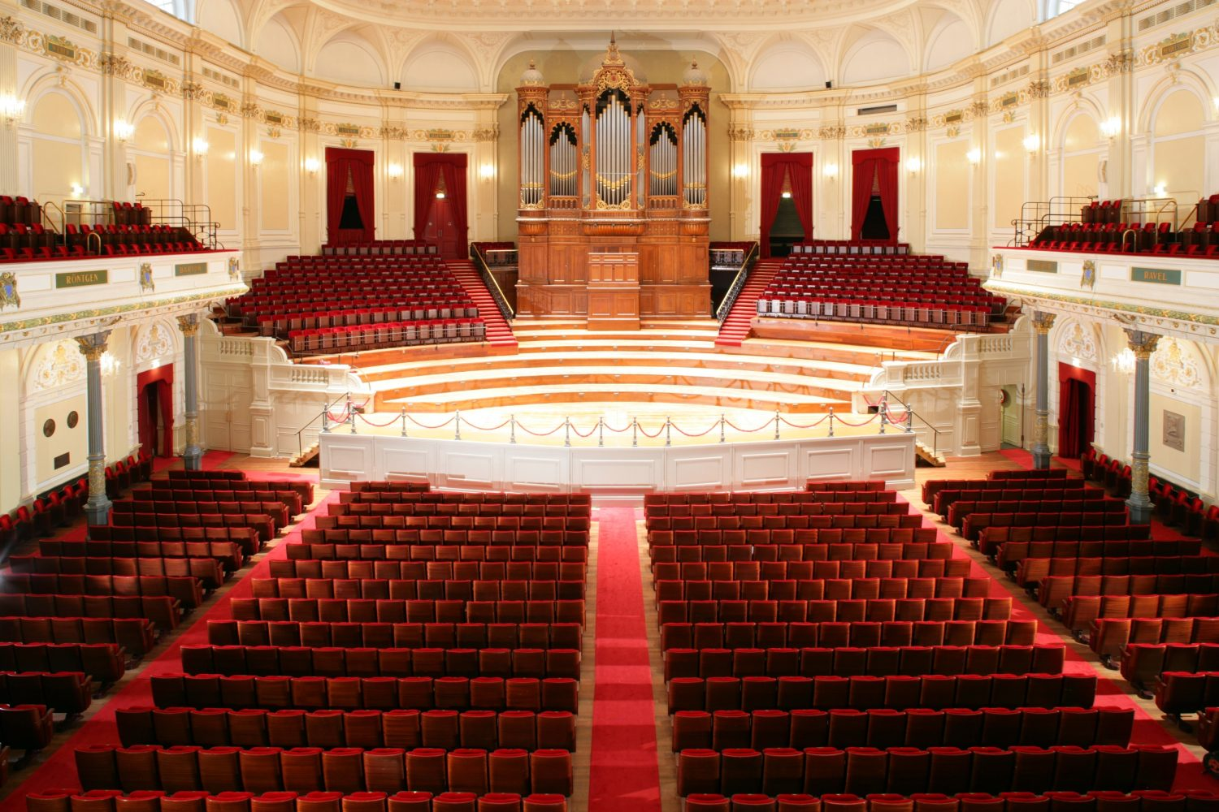
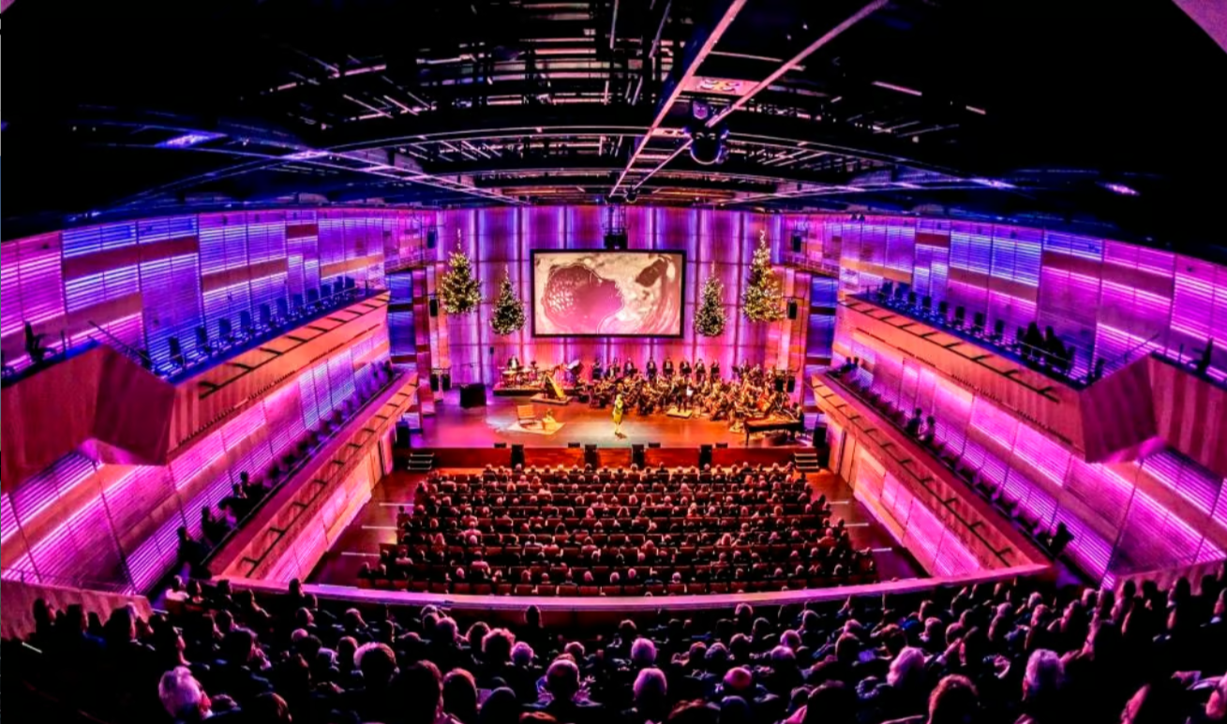
Conference dinner: First options
Beurs van Berlage
€236
Too expensive
Concertgebouw
€177 (1000), €222 (500)
Great location, too expensive
Muziekgebouw aan ‘t IJ
Not available
Based on Montreal we expect ≥500 participants, but that was on Thursday evening, so we can expect more.
Find a cheaper location (say ≤ €150) with possibly smaller capacity!

Slide 12
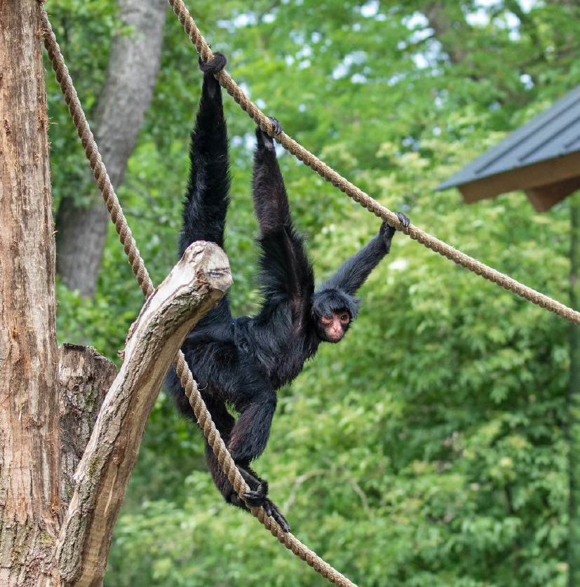
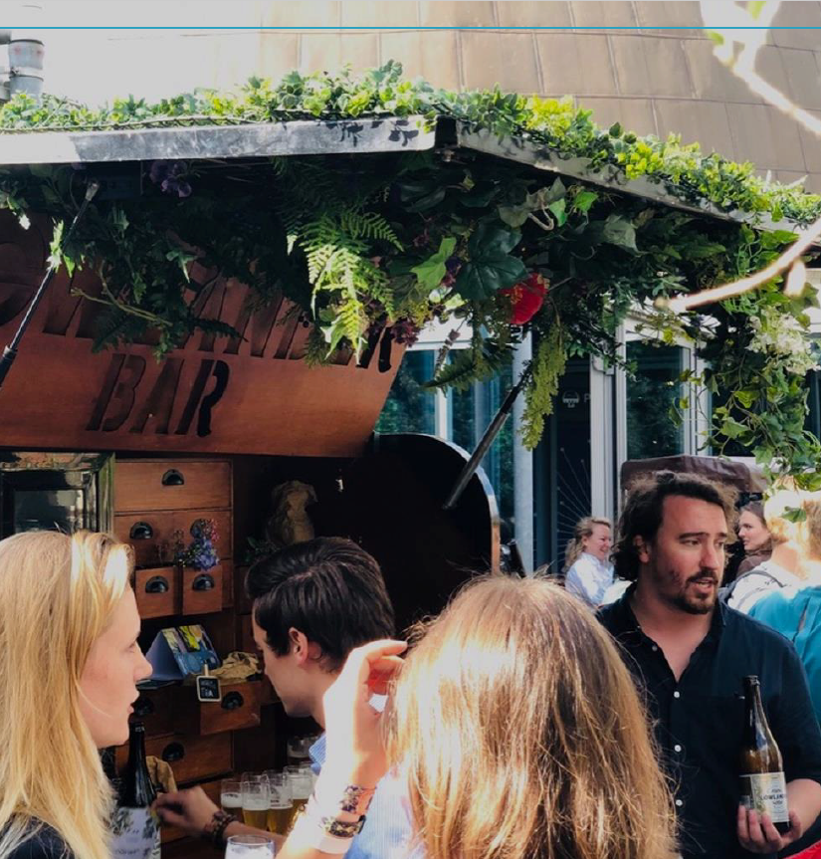
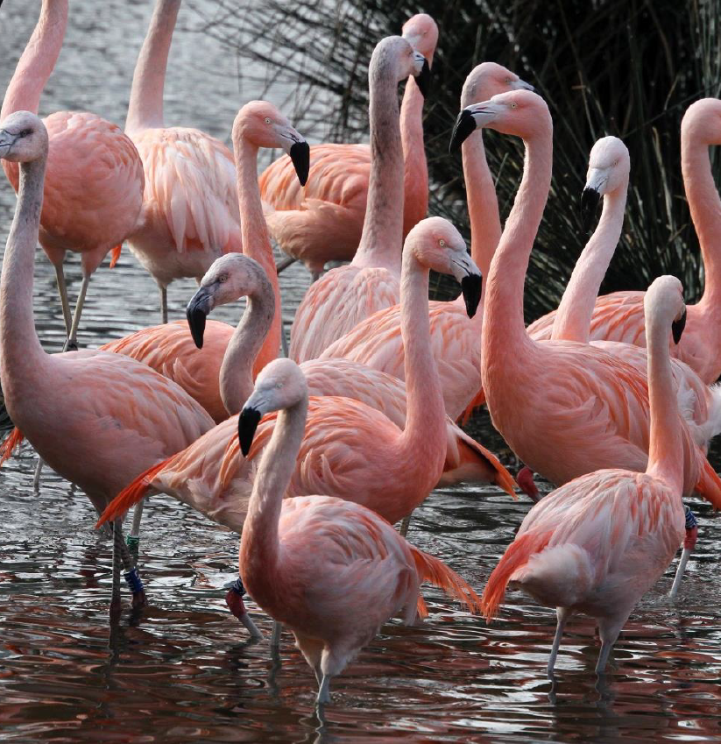
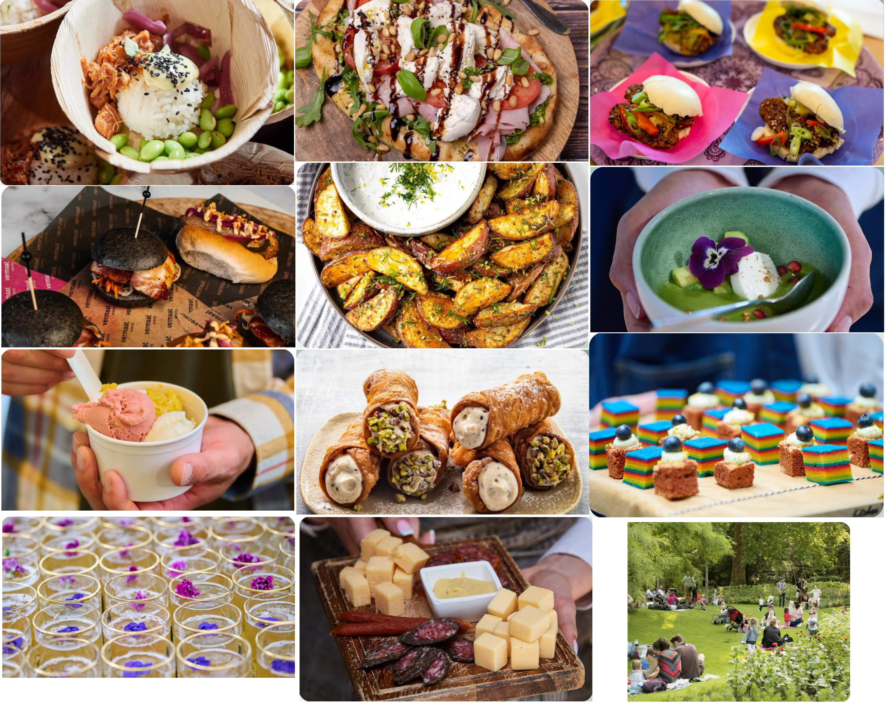
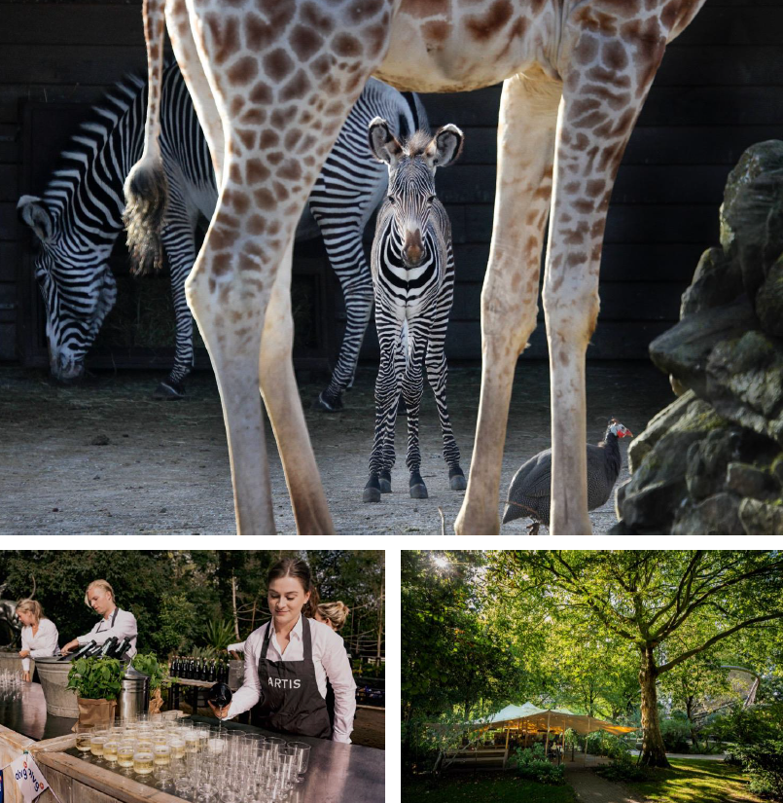
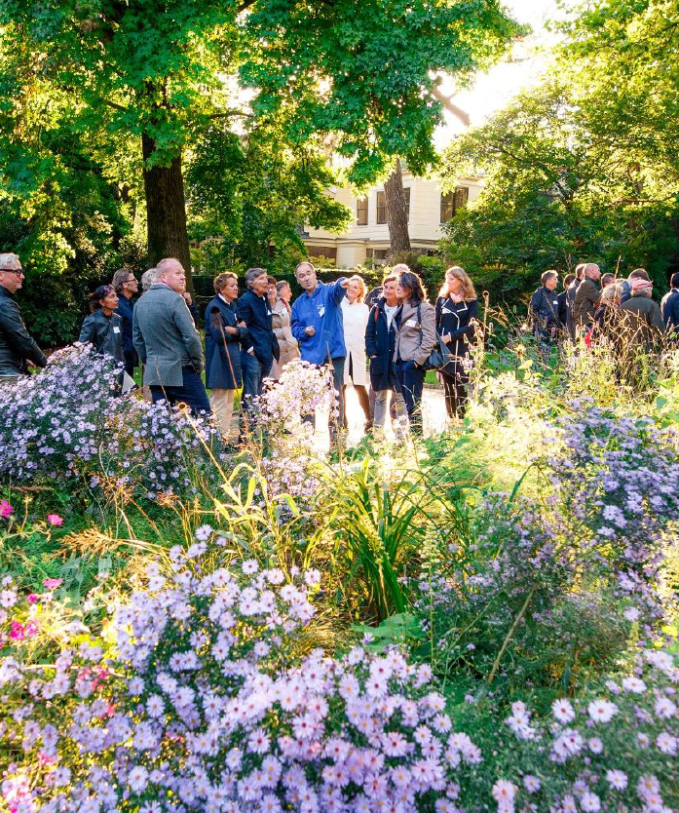
Conference dinner: ARTIS
Price: €149 (1000 people) to €176 (500 people)
The entire park is open exclusively for us
Four fancy street food dishes per person
Luxury flat breads
Poké bowls
Bao buns
Brioche burger buns
Loaded wedges
Green gazpacho
Two desserts per person
Ice cream
Spekkoek
Sweet cannelloni
Juices, sodas, water, beer and wine included
We can optionally include a welcome drink (+€8.50) or a charcuterie bar (+€7.50)

Slide 13
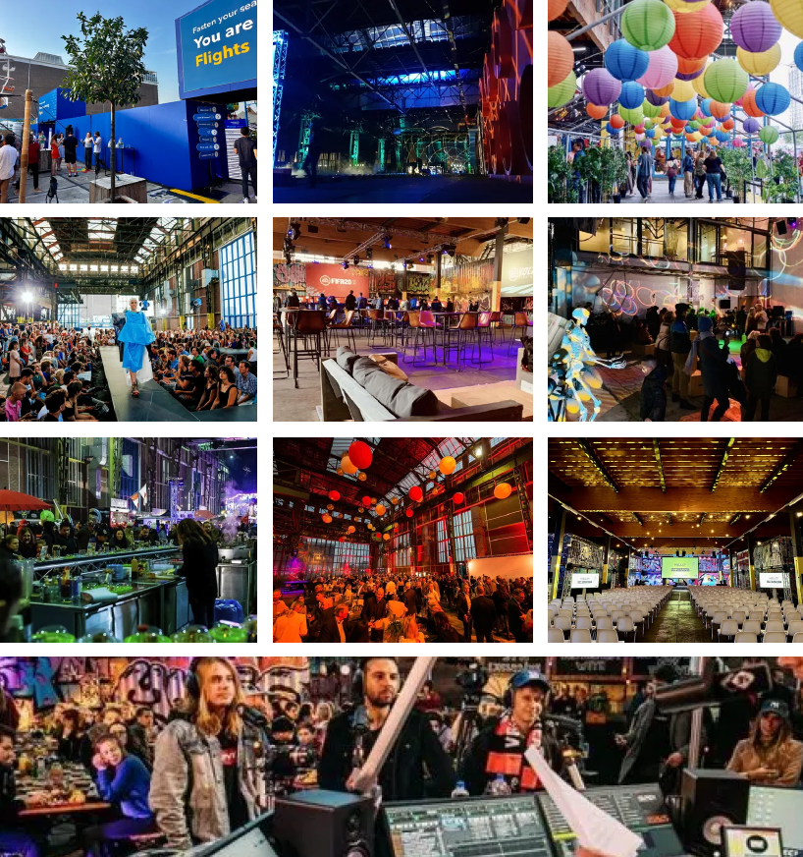
Conference dinner: NDSM loods
Price: €141 (1000 people) to €208 (500 people)
Juices, sodas, water, beer and wine included
Very basic food stations
Fries
Satay
Burgers
Kebab
Hotdogs
Burritos
Spring rolls
Febo Snack wall
Ice cream
Higher price for
less quality!

Slide 14
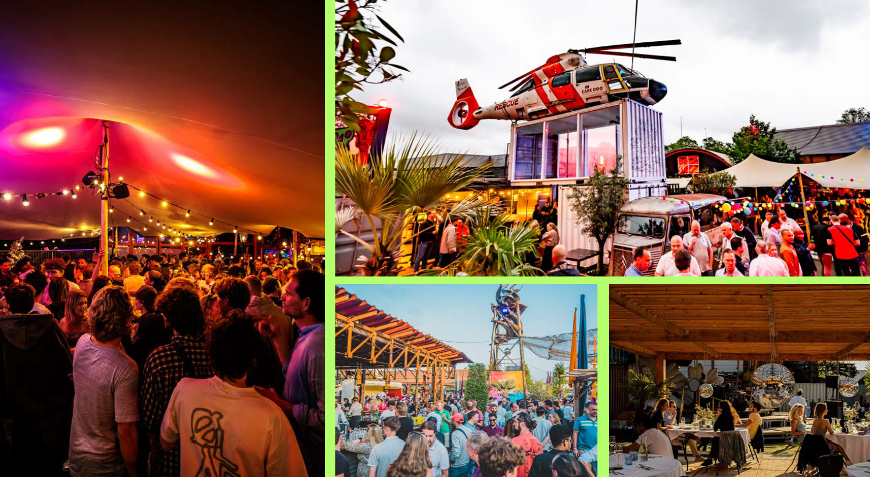
Conference dinner: LIEF
Price: €130 (1000 people) to €145 (500 people)
Food not clear so far, basic impression
Juices, sodas, water, beer and wine included
Location is next to a highway
We need a shuttle service
from Amsterdam Sloterdijk
Not much of an experience
A bit cheaper, but we think it is
not worth the price difference

Slide 15
Conference dinner: Choice
Issue: Quality VS Costs
Bring costs down further for ARTIS:
We try to lower the costs further, possibly by paying all drinks instead of a general buyout
Alternative options:
Split over several restaurants (but logistical issues, we do not expect it’s much cheaper)
A cheaper smaller location with a cap of say 500 participants (but not everyone can join)
Come to Guido Schäfer, Leen Stougie, Tjark Vredeveld or me if you have input!
Started with €236 per person
ARTIS
Price: €149 (1000 people) to €176 (500 people)
The entire park is open exclusively for us
Fancy street food served throughout the park
NDSM loods
Price: €141 (1000 people) to €208 (500 people)
Basic street food in urban setting across the IJ
LIEF
Price: €130 (1000 people) to €145 (500 people)
Location is unattractive and hard to reach
Food not clear so far, basic impression

Slide 16
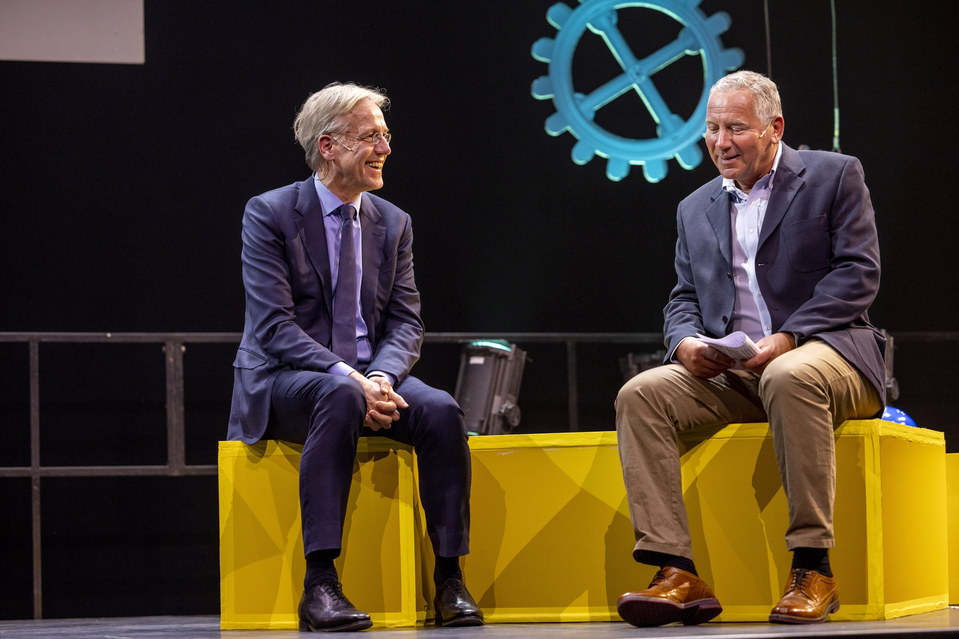
Outreach to the Public
Two Evening Events On impactful Applications of Optimization & OR
Gala van de Wetenschap 2022

Slide 17
Cost Estimation and Fees
Estimated Costs for 2000 Participants
Category | Cost (€) | Average Cost Per Person (€)
Venue | 404,410.44 | 202.21
Catering | 313,945.00 | 156.97
Equipment | 182,690.88 | 91.35
Marketing and Communication | 26,345.00 | 13.17
Support for Invited Speakers | 37,500.00 | 18.75
Participant Materials | 19,630.00 | 9.82
TUE Conference Center | 113,460.00 | 56.73
Unforeseen Expenditures | 59,084.41 | 29.54
Estimation Inflation | 100,886.95 | 50.44
Total | 1,258,021.48 | 629.01
Registration Fee
Category | Early Fee Per Person (€) | Normal Fee Per Person (€) | Late Fee Per Person (€)
Regular | 710-770 | 840-910 | 990-1080
Retirees | 310-340 | 370-400 | 430-470
Students | 270-300 | 320-350 | 380-410
Every €100K sponsorship reduces the fees by approximately €60.

Slide 18
Sponsorship Prospectus
We are offering the following opportunities to sponsors:
ISMP 2027 Event Sponsor
The following events can be named by the sponsor:
Welcome Reception
Conference Dinner
Invited Speaker Dinner
Farewell Reception
The required sponsorship amount for naming is subject to negotiation.
Visibility Options
Logos displayed on
Website
Banners
Intro slides
Non-intrusive advertising in the Conference App
Logo on:
Lanyards
Nametag
Conference Pen
Notepad
Conference bag
Booth
Meeting/Interview Rooms at RAI

Slide 19
Sponsors up-to-now
and many more to come!

Slide 20
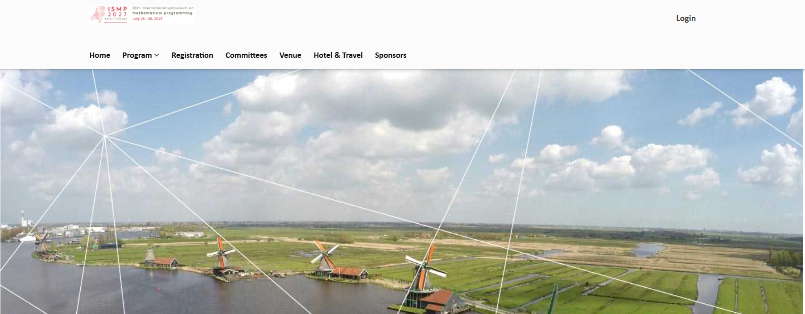
Website
ismp2027.mathopt.nl
#ISMP2027 in social media

Slide 21
Actions to organize ISMP2027
Actions for the future
Create the scientific programme (primarily by MOS)
Finalizing the social program
Expand the website, develop App to navigate the scientific program
Finalizing the sponsorship packages
Actively search for sponsors
Advertising ISMP 2027 via different channels
Gather ideas about satellite events
Finalizing the discounted accommodations
Mobilize students to help during ISMP 2027
Finalizing the catering options
And many more …
Date | Undertaken Actions
May 2024 | Bidbook was submitted
June 2024 | Bid was won and announced during ISMP2024
October 2024 | The contract with RAI was signed by TUe
November 2024 | Logo was designed
December 2024 | Website was made Initial sponsorship packages were made

Slide 22
Let us join forces to make ISMP2027 memorable!

