Slide 1
50 years LNMB(?) conferences My journey to and with the LNMB and its conferences
Johann Hurink

Slide 2
Past Experiences with ´OR´-conferences
1985 – 1998, Osnabrück, Germany
1985: DGOR conference Osnabrück
Student assistant supporting organisation
Met a few Dutch delegates (having beer together)
1987 – 1997: PhD and PostDoc period Universität Osnabrück
Participated yearly in the German conferences
Participated in some EURO/INFORMS conferences
OR ´organizations´
Deutschen Gesellschaft für Operations Research (DGOR)
´Gesellschaft für Mathematik, Ökonomie und Operations Research (GMÖOR)
since 1998 merged to: Gesellschaft für Operations Research (GOR)

Slide 3
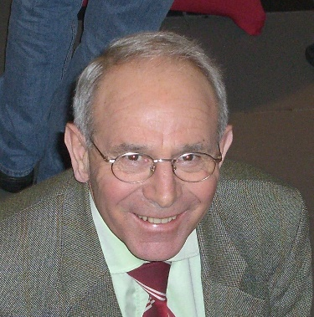
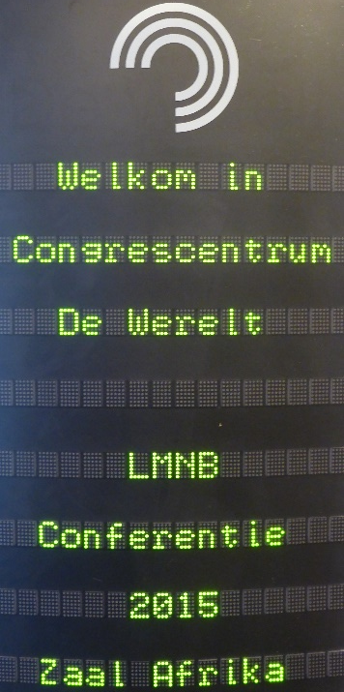
1998: My move to The Netherlands
First ´contact´ with the LNMB
Started as UD in April 1998 at UT in the group of Ulrich Faigle (he was a German)
Autumn 1998: Annoucement LNMB Conference Lunteren
Ulrich Faigle
´This is the place to be!´
Here you meet people with whom you can collaborate
Here you meet people who will ´judge´ you at some time
…
… and he also mentioned:
here you get insights in the current hot topics of OR worldwide presented by excellent researchers and speakers
here you get insight of what is ongoing within Math of OR in The Netherlands

Slide 4
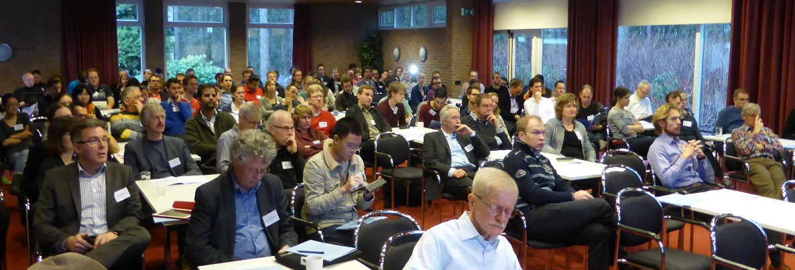
My Experiences with ´LNMB´-conferences
1999 – 2025, Lunteren-Soesterberg
!! Ulrich was completely rigth !!
Impressive list of invited speaker!
Why no speakers from our own Dutch OR groups (is this even true?)!
Good insigth in ongoing research in ´Math of OR´ in NL via PhD presentations
Consequence: I missed no ´LNMB´ conference since 1999!
It is content, networking and fun
And: I give the same advise as Ulrich gave me to new OR-researchers moving from abroad to The Netherlands

Slide 5
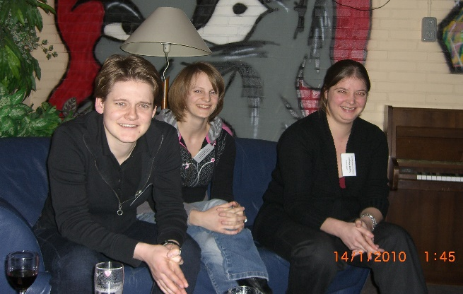
Maximize Return of Investment of ´LNMB´-conferences
My ´Personal´view´!
It is not sufficient to only focus on the talks!
Breacks, lunches and dinners are also crucial (networking!)
Do not always join the same group!!
Also ´Games´ seem to gave a good impact on building your network
Two ´personal statements´:
If you participated in a Lunteren conference and you never saw the ´Onderwereld´ - you missed some essential part of the conference!
Disadvantage of Soesterberg location is: the bar closes too early!

Slide 6
PhD and Master Education offered by LNMB
Or ´my missunderstanding´ of the roots of LNMB
Reform of academic education in NL 1987 asked for seperate PhD education
→ Foudation of LNMB in July 1987
Only from 1992 on LNMB was involved in Lunteren conference
Only from 2001 on LNMB took over full organization of Lunteren conferences
In 2000 the small number of Mathematic master students in NL made it difficult to offer specialized master courses
Foundation of Mastermath
LNMB organized OR-track within Mastermath
My view: the existing cooperation/network of ´Math of OR´ in context of organizing the ´Lunteren conferences´ was a prefect base for the above

Slide 7
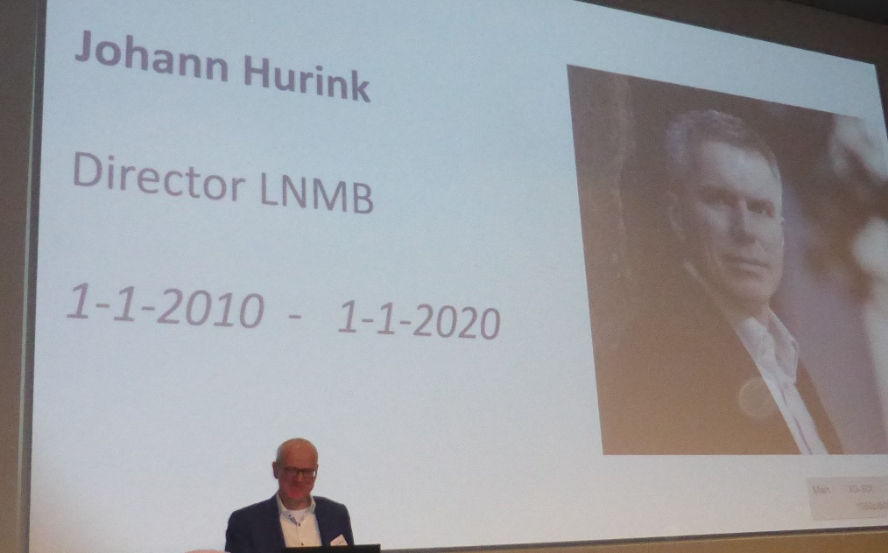
My ´Final WordS´
(for now)
Keep the basic setup/format of the LNMB conferences
´Figth´ with your Graduate Schools to have sufficient/more room for ´content-oriented´ courses in PhD-education part
Give PhD students more room for choice (do not make too much courses obligatory – only a few essential)
Let the PhDs with their supervisors decide what is best!
Offer the PhD courses not(!) online but physically – networking is important!
Summary: For me having the LNMB as ´my chair´ was the best what could have happend in my academic carrier – Thank you all!

